Slide 1
Python

Slide 2
INTRODUCTION
What is Python
History of Python
Versions
Comparing Python with other languages
Features
Applications
Limitations

Slide 3
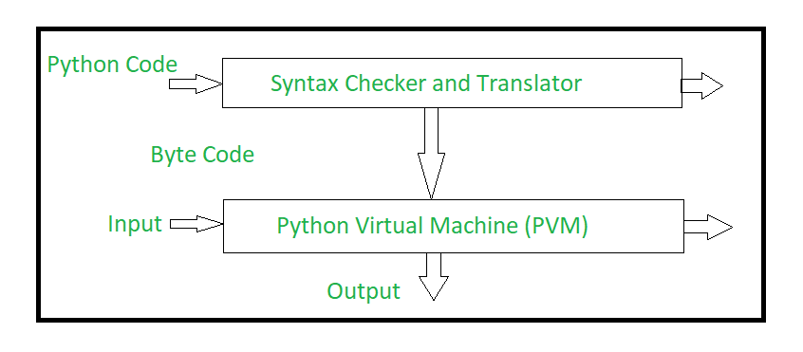
What is Python ?
Python is a general purpose, high-level, interpreted, interactive, scripting, procedure and object-oriented programming language.
Python is a programming language that combines features of C and Java.

Slide 4
History
Work on Python began in late 1989 by Guido van Rossum in Netherlands.
In the year 1989, he started to prepare a Simple Scripting Language to resolve the problems of ABC programming language.
But officially Python was made available to public in 1991. The official Date of Birth for Python is : Feb 20th 1991.
“Python” name was taken from a famous comedy serial which was broadcasted in BBC in 1970’s called “Monty Python’s Flaying Circus”
He has given name "Python" to the programming language as he was a big fan of "Monty Python's Flying Circus" TV Show.

Slide 5
Version
Python 0.9.0 - February, 1991
Python 1.0 - January 1994
Python 2.0 - October, 2000
Python 3.0 - December, 2008
Python 3.1 - June, 2009
Python 3.2 - February, 2011
Python 3.3 - September, 2012
Python 3.4 - March, 2014
Python 3.5 - September, 2015
Python 3.6 - December, 2016
Python 3.7 - June, 2018
Python 3.8 - October, 2019
Python 3.9 - October, 2020
Python 3.10 - October, 2021
https://www.python.org/doc/versions/
Python 3.5+ cannot be used on Windows XP or earlier.

Slide 6
Comparisons Between C,JAVA and Python
Simple when compare to C,C++,JAVA
Static and Dynamic Programming Language
Platform Dependency
Procedure and Object Oriented
Statically Typed and Dynamically Typed

Slide 7
Features
Easy to Learn
Freeware and Open Source
High Level Language
Platform Independent
Portable
Dynamically Typed
Both Procedure and Object Oriented
Interpreted
Extendable/Extensive
Embedded
Huge Library
GUI Programming

Slide 8
Application for Python
Web Application – Django, Pyramid, Flask, Bottle
Desktop GUI Application – Tkinter(Calculator)
Console Based Application- Command Prompt
Games and 3D Application(Pirates of Caribbean)-kivy, pygame
Network Application- Socket
Scientific and Numeric Applications-Numpy,Scipy
Data Science-Numpy,pandas
Machine Learning - scikit-learn and TensorFlow
Data Analysis - Matplotlib, Seaborn
Business Application
IOT- Resberypy
https://www.python.org/about/apps/

Slide 9
Limitations
1. Performance and Speed
2. Incompatibility between Two Versions

